Slide 1
Introduction to C#
Building your first apppliaction

Slide 2
Lesson Plan
Installing Visual Studios 2019 Community
Understanding Visual Studios 2019 Development Environment
Creating a Hello World Program
Learning about built-in Types and Variables
Working with Strings
Working with Dates and Times
Making Decisions in Your Program
Implementing Logical Expressions

Slide 3
Lesson Plan Cont.
Looping Based on a Logical Expression
Looping a Known Number of Times
Working with Arrays and Collections
Looping Through Members of a Collection
Defining and Calling Methods
Understanding Classes and Objects
Working with Scope and Accessibility Modifiers
Encapsulation and Object-Oriented Design
Understanding Namespaces
Introducing LINQ
When and How to use Exceptions
Testing Your Code
Common Patterns and Antipatterns

Slide 4
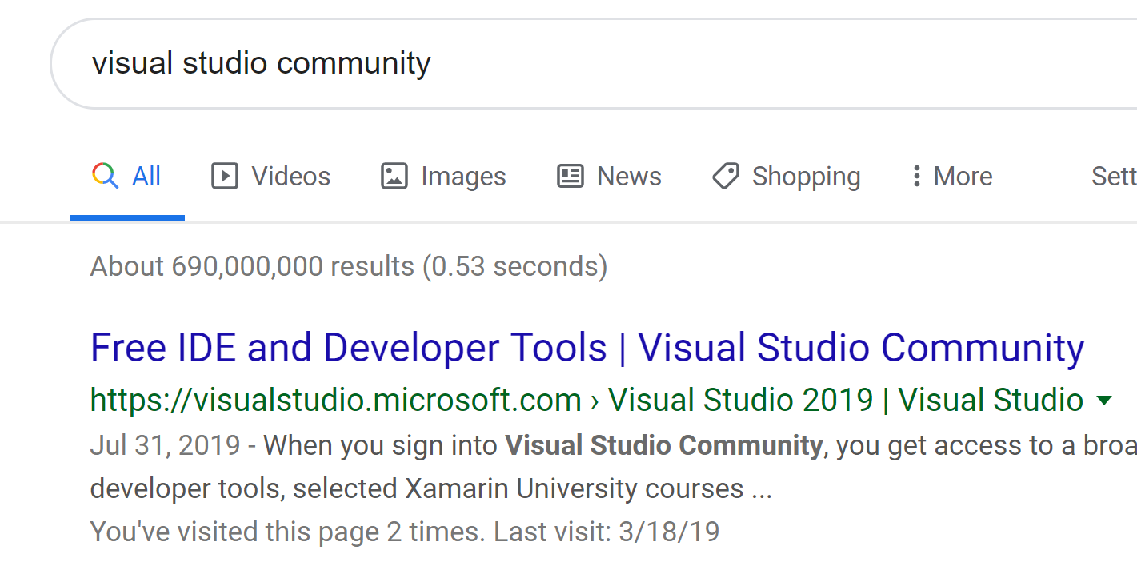
Installing Visual Studios 2019 Community
Perform a Google Search for “Visual Studios Community”
Click on the “Free IDE and Development Tools” link

Slide 5
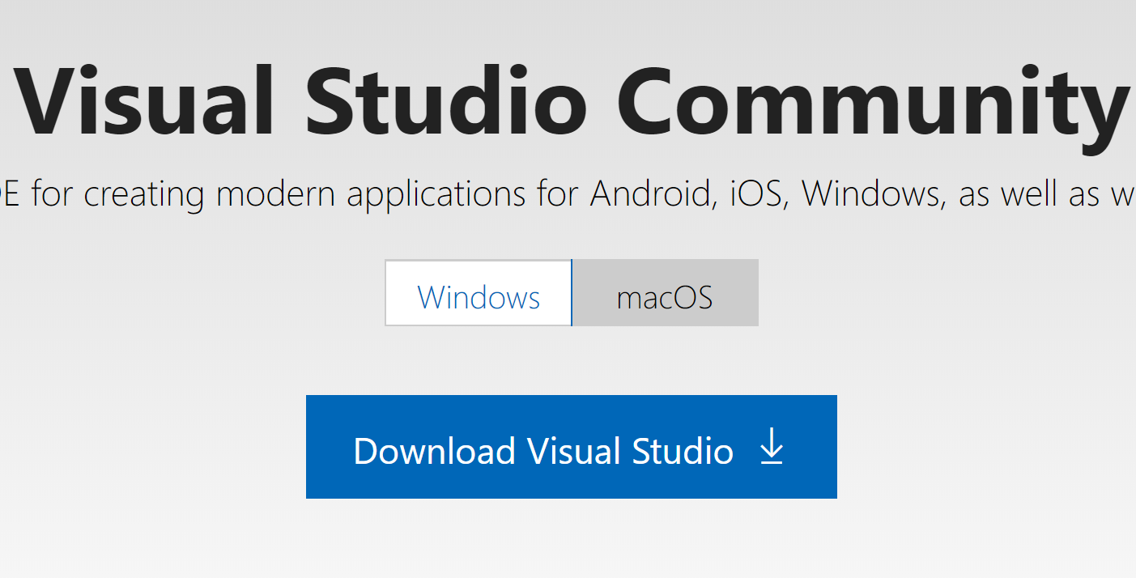
Microsoft Website Download Link
Click on the “Download Visual Studio” link
After download completion (about 5 seconds)
Open the downloaded file to begin the installation
When asked for permission select “YES”

Slide 6
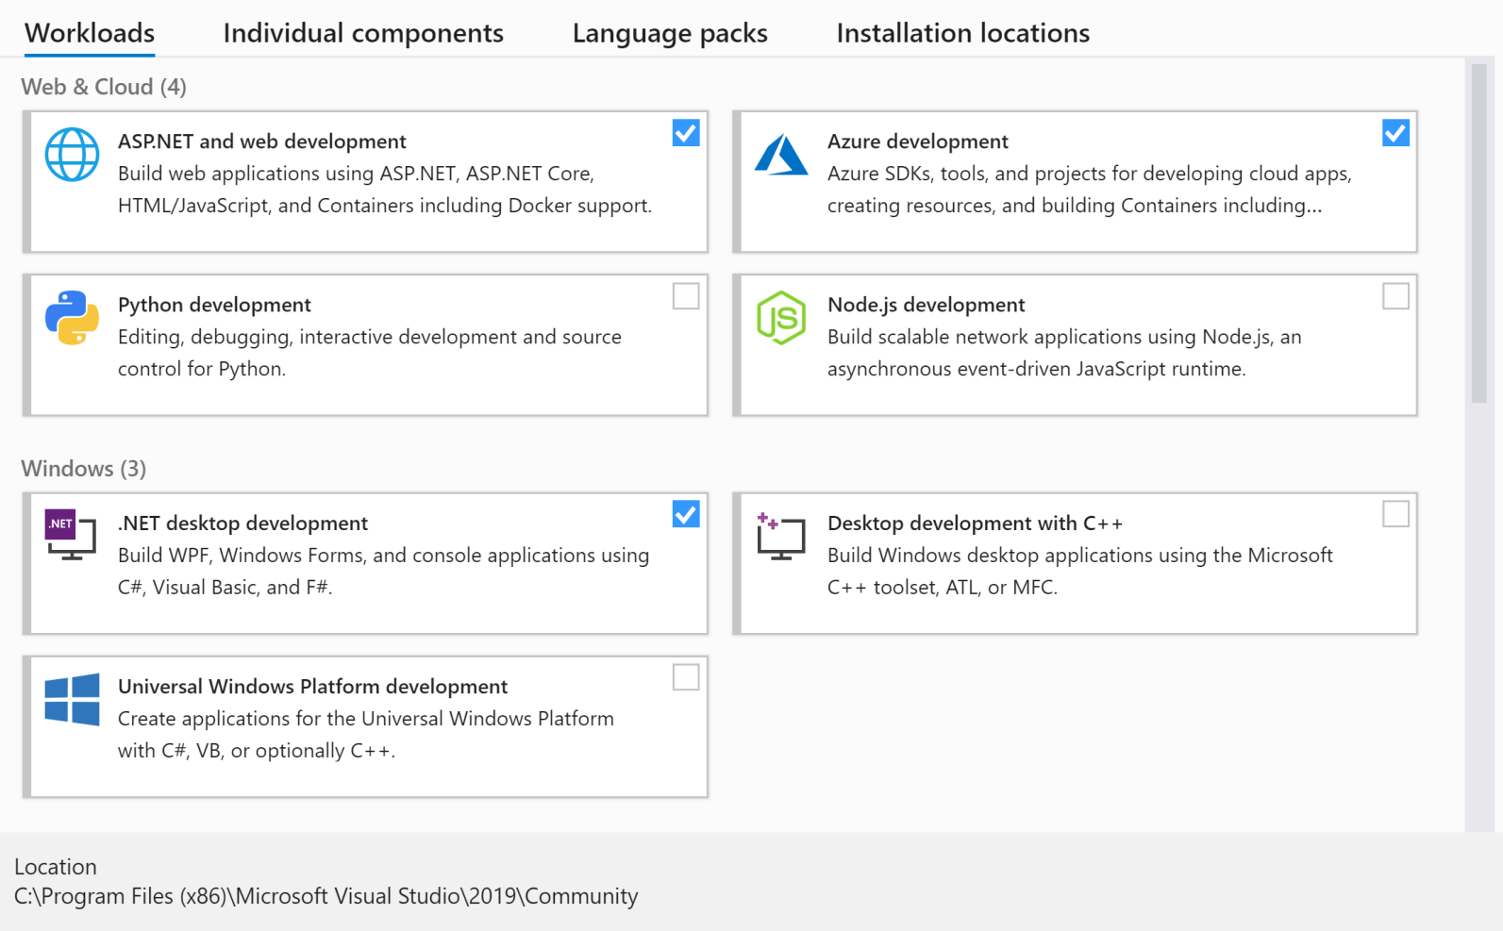
Visual Studios Install Settings
Ensure that each above options are selected
Do NOT select install at this time as there are more options to select.

Slide 7
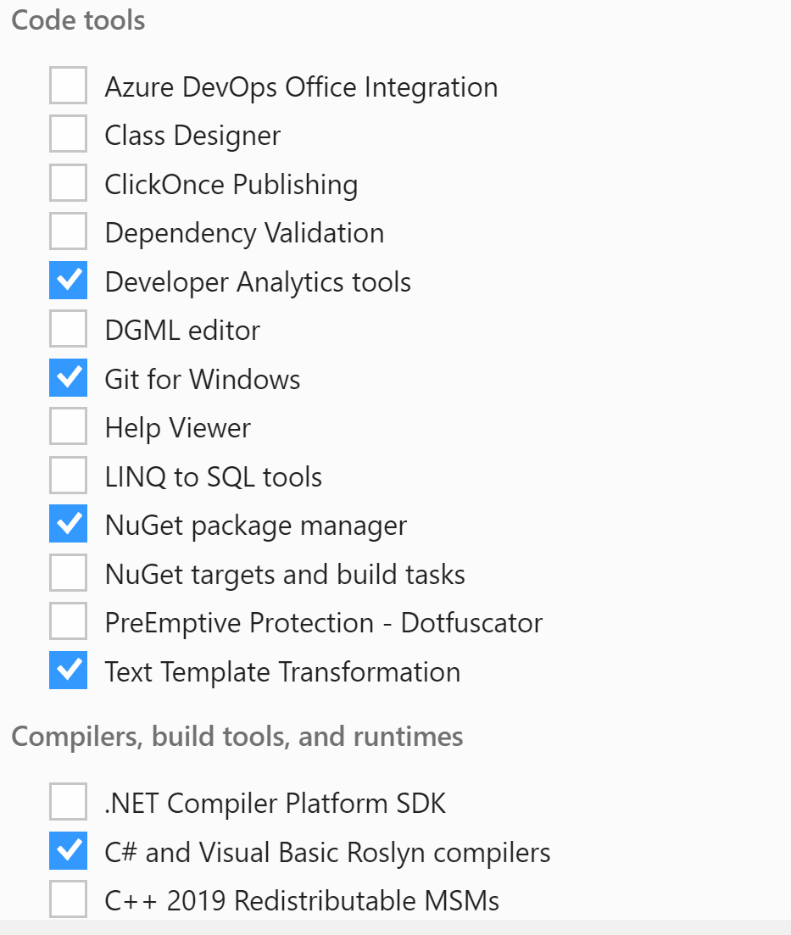
Visual Studios Code Tools
Ensure that each above options are selected
Do NOT select install at this time as there are more options to select.

Slide 8
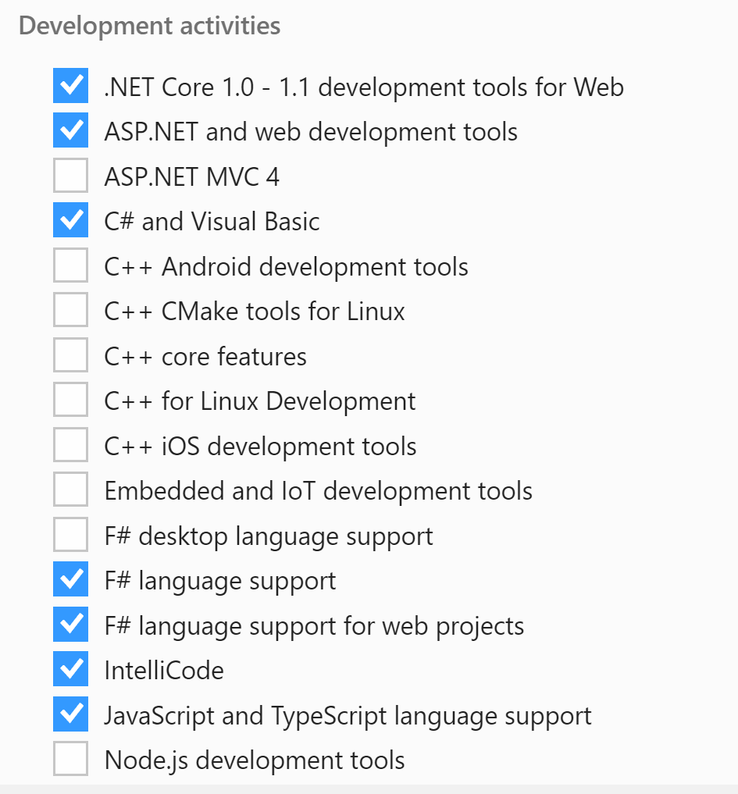
Visual Studios Development Activities
Ensure that each above options are selected
NOTE: .NET Core 1.0-1.1 is not selected by default.

Slide 9
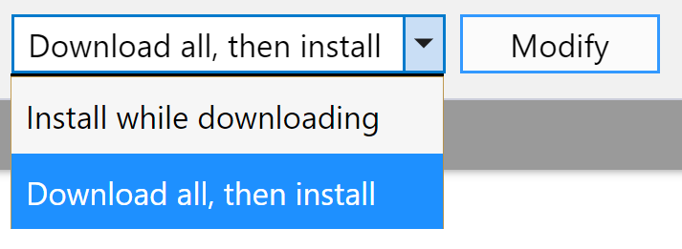
Visual Studios Begin Installation
Once all options have been selected, ensure “Download all, then install” is selected.
Select the “Install” button
NOTE: Due to already having this installed, my version shows “Modify”, however new installs will show “Install”

Slide 10
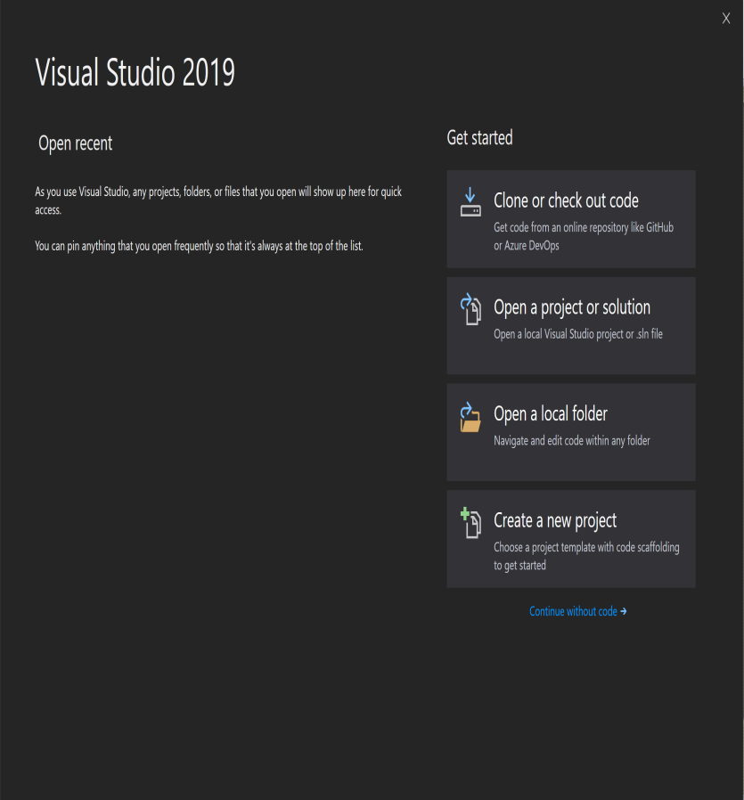
Visual Studios Startup Screen

Slide 11
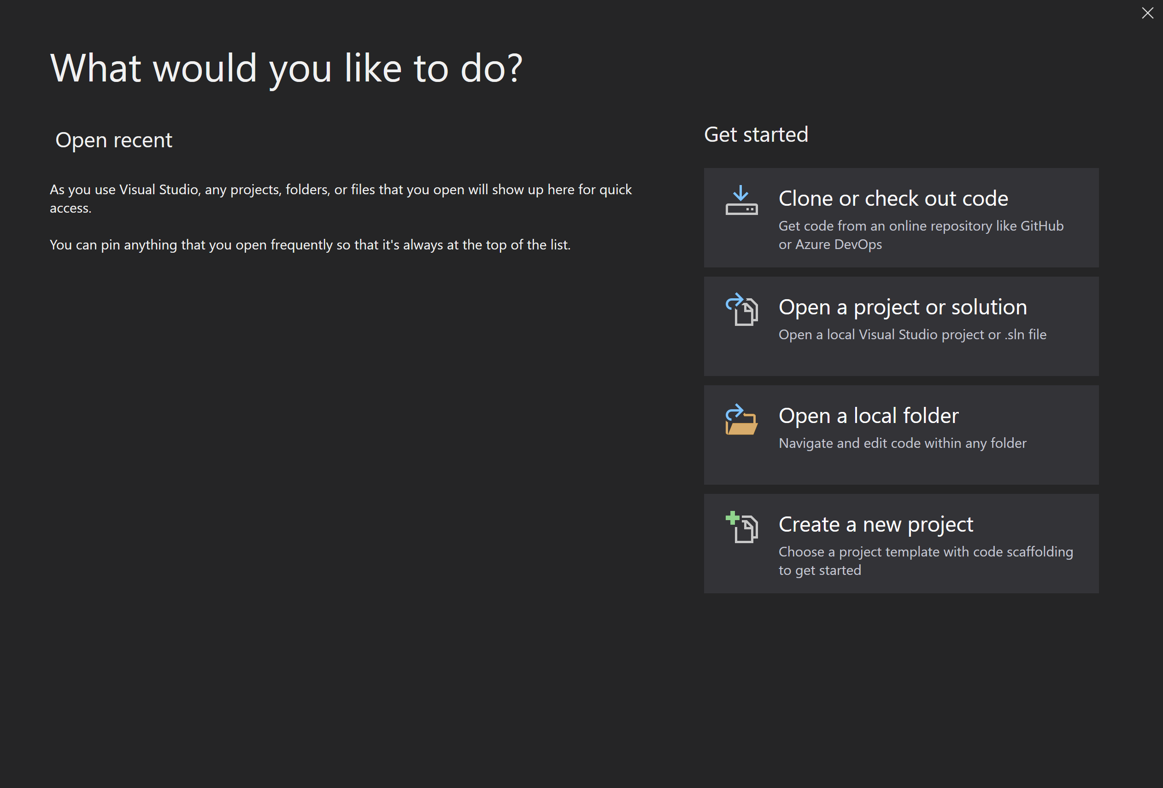
Cloning a Repository

Slide 12
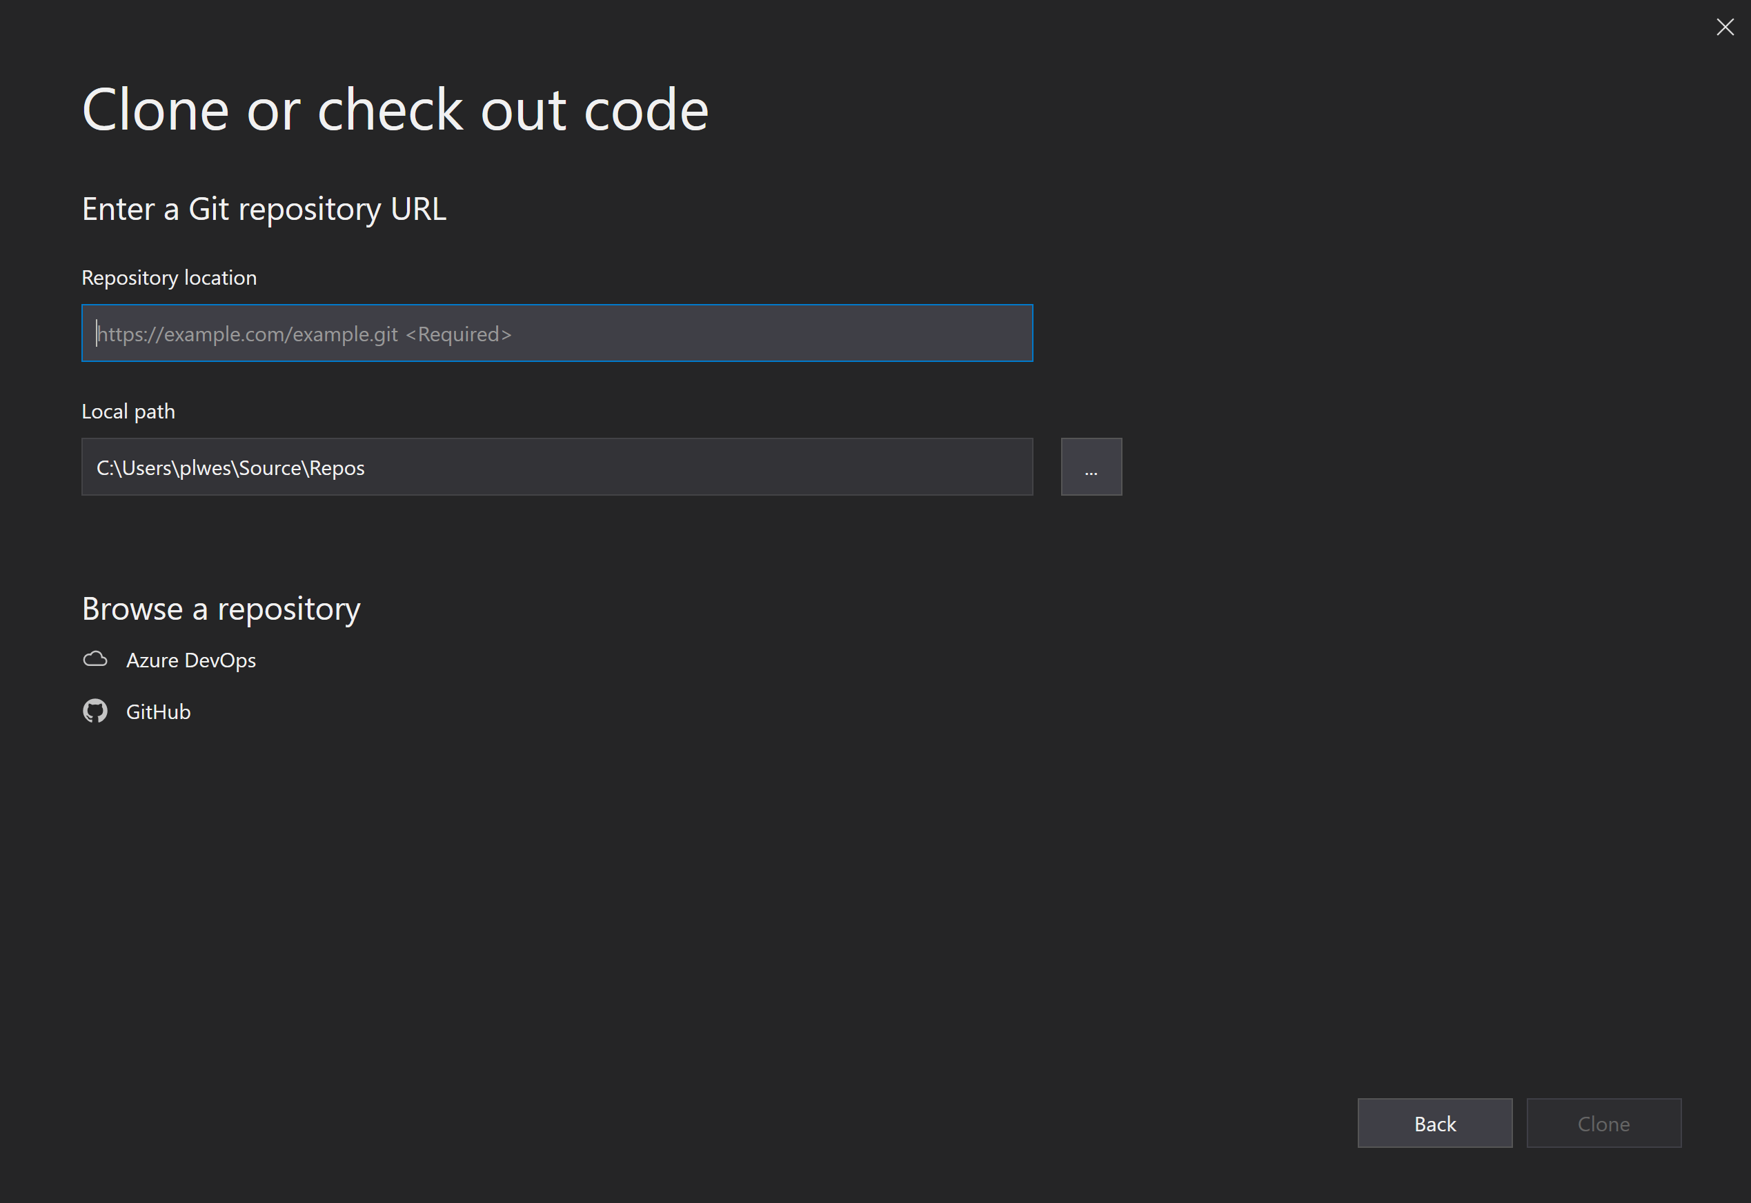
Cloning a Repository
https://github.com/plwest-atmark/Aug31.git

Slide 13
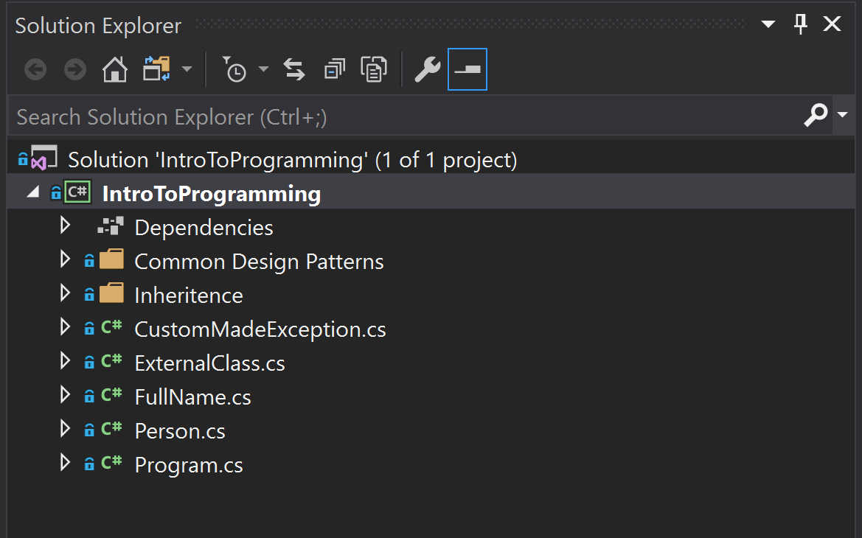
Visual Studio Solution Explorer

Slide 14
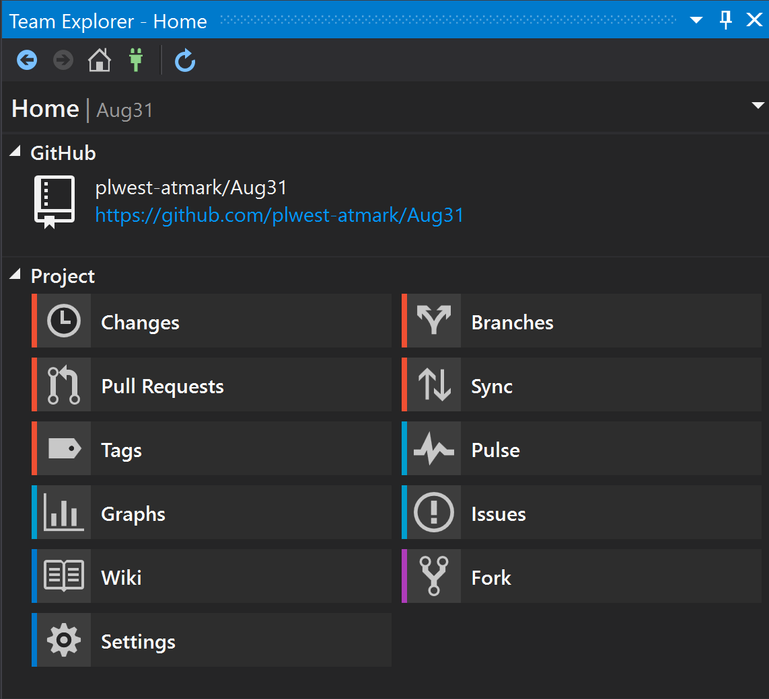
Visual Studio Team Explorer

Slide 15
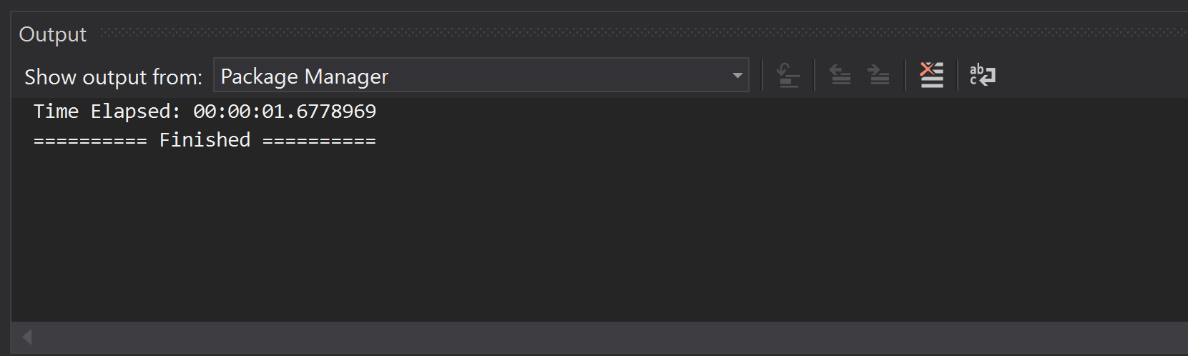
Visual Studio Output Window
Output window will display important information about the application during Build Actions and during Debugging Actions.
This window will also be used to provide feedback created by you during the running of your application. This is done with Tracing and Debugging outputs.

Slide 16
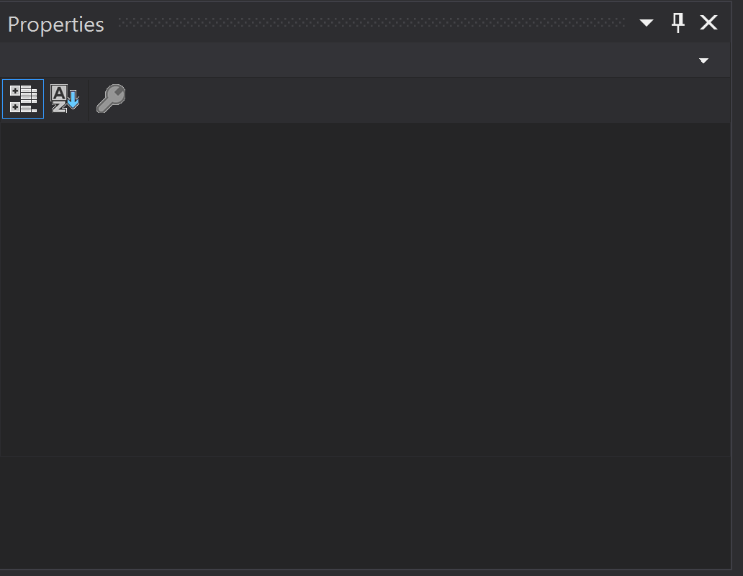
Visual Studio Properties Window
Output window will display important information the properties of User Interface components. During console applications this is not a very active window. However, when we moved to MVP and Web Application Development, this will become a very important window. For now, just remember that it is there and in the next lesson we will utilize it more.

Slide 17
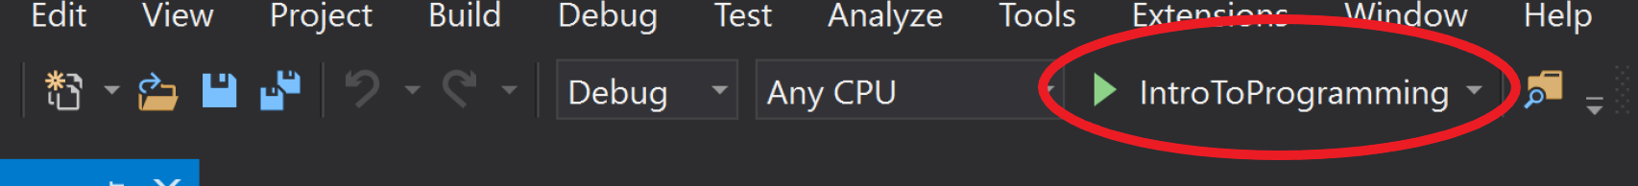
Running the Console Application
This toolbar is utilized to “Run” the program. It will act in a similar manner as double clicking on an application that is installed on a computer.
The two settings to the right of the green arrow are as follows:
Debug – This is a setting to attach a debugger to the program or run the program without debugging.
Any CPU – This is a setting to target “Any CPU”, “x32”, or “x64”. This becomes relevant when applications begin to utilize a large amount of RAM as an operating system that is “x32” has a maximum RAM limitation of 3GB. “x64” operating systems are not limited by this.
Shortcut Key: F5
S

Slide 18
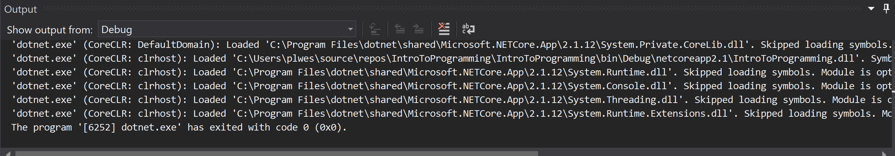
Visual Studio Output Window (Good build)
Note that after “Running” the application the Output Window now shows a considerable amount of information. Due to the nature of a Console Application, most of the debugging setup is skipped as it is not relevant and not necessary. However, if there are errors, this is where they would show.

Slide 19
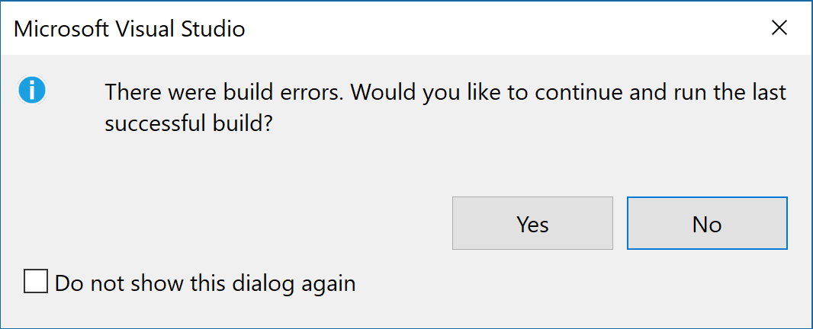
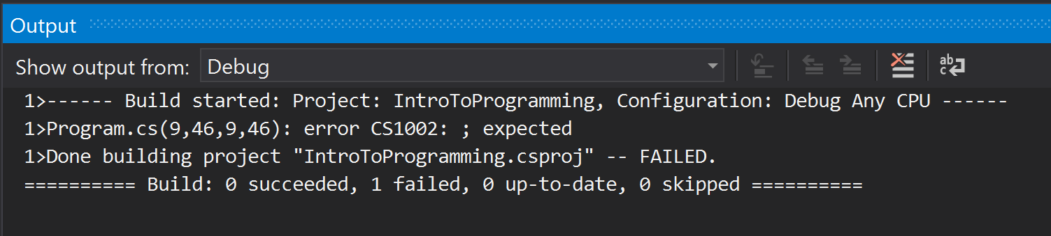
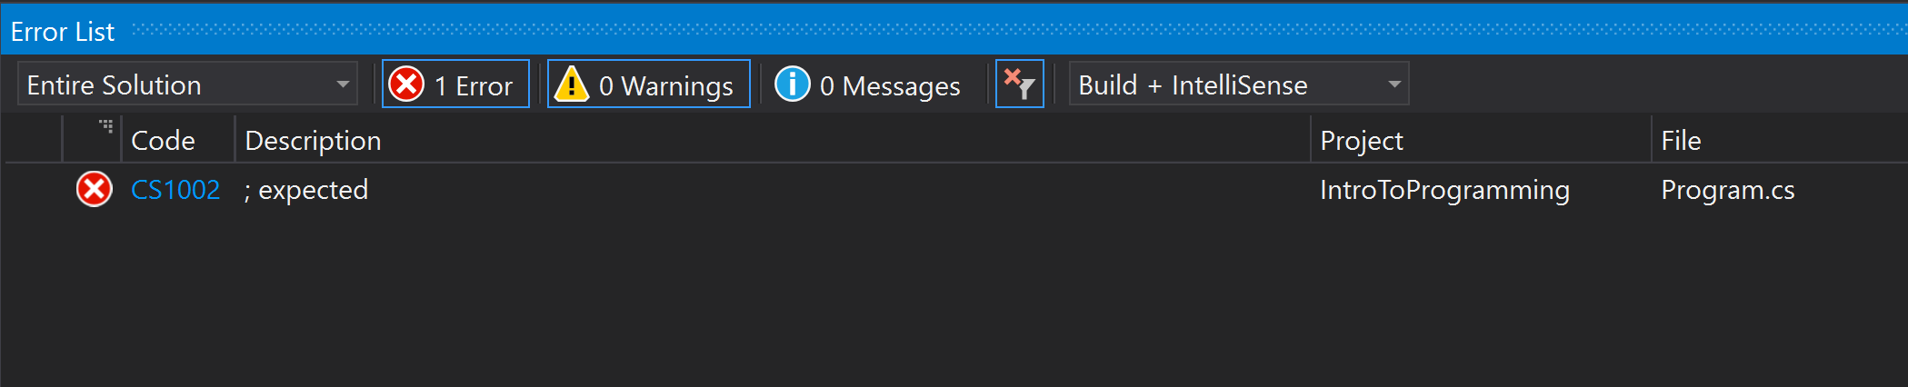
Visual Studio Output/Error Windows (Failed Build)

Slide 20
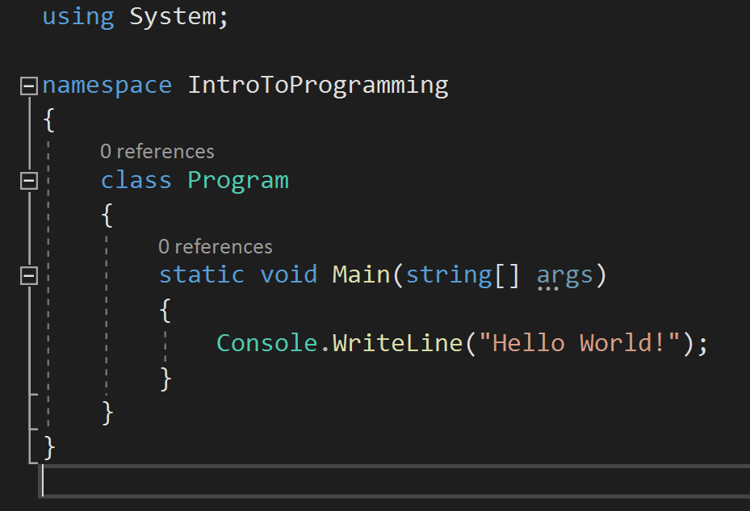
Basic Program Breakdown
The using keyword has three major uses:
The using statement defines a scope at the end of which an object will be disposed.
The using directive creates an alias for a namespace or imports types defined in other namespaces.
The using static directive imports the members of a single class.

Slide 21
Basic Program Breakdown
The namespace keyword is used to declare a scope that contains a set of related objects.
You can use a namespace to organize code elements and to create globally unique types.

Slide 22
Basic Program Breakdown
The Main method is the entry point of a C# application.
When the application is started, the Main method is the first method that is invoked.
There can only be one entry point in a C# program. (This is an exception, but is beyond the scope of this class)

Slide 23
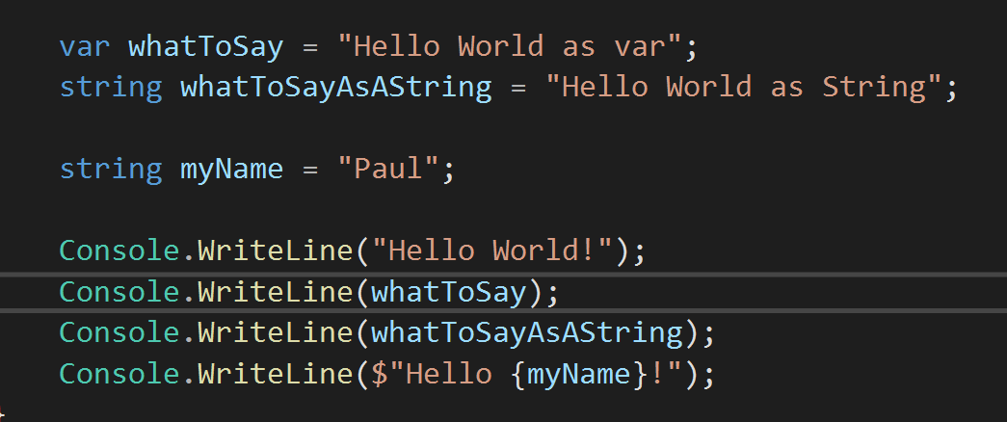
Introduction to Variables (var and string)
var keyword can be used to create a “variable” that is made into the type on the right side of the “=“.
string is used to STRONLY type a variable. This means that what is on the right side MUST be a string.
The “$” in “Console.WriteLine($”Hello {myName}!”);”allows for easy access to variables to make more complicated and dynamic strings.

Slide 24
Introduction to Variables (var and string)
var keyword can be used to create a “variable” that is made into the type on the right side of the “=“.
string is used to STRONLY type a variable. This means that what is on the right side MUST be a string.
The “$” in “Console.WriteLine($”Hello {myName}!”);”allows for easy access to variables to make more complicated and dynamic strings.

Slide 25
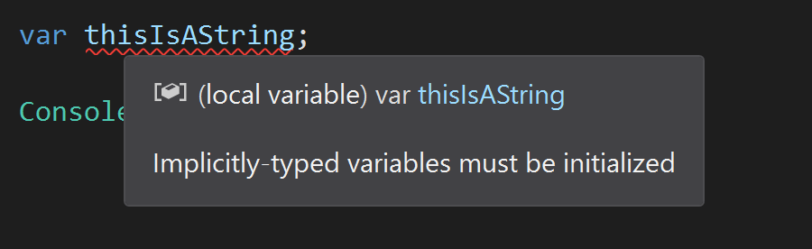
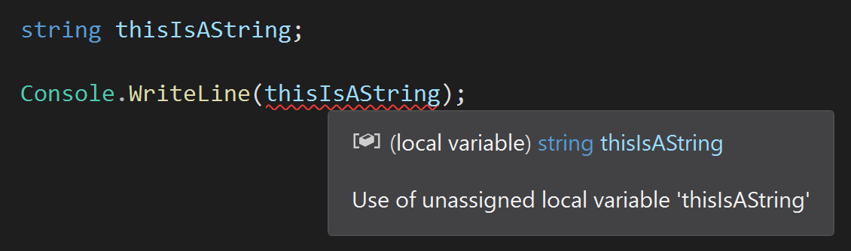
Introduction to Variables (var and string)
1
2
When specifying a var, it MUST have something assigned to it. This tells the “compiler” what “type” the var is going to be.
If a strongly typed variable is declared, then it must be assigned a value before it is used.

Slide 26
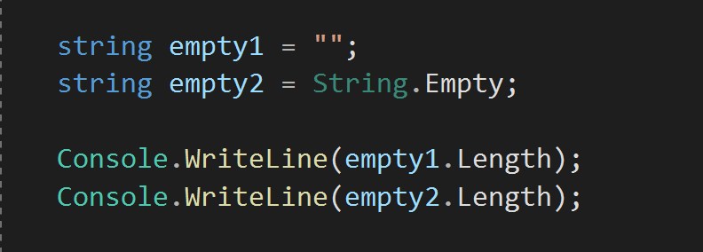
Strings with No Length
If a string that is not NULL needs to be created, there are two ways
Assign the string a value of “”
Assign the string a value of “String.Empty”

Slide 27
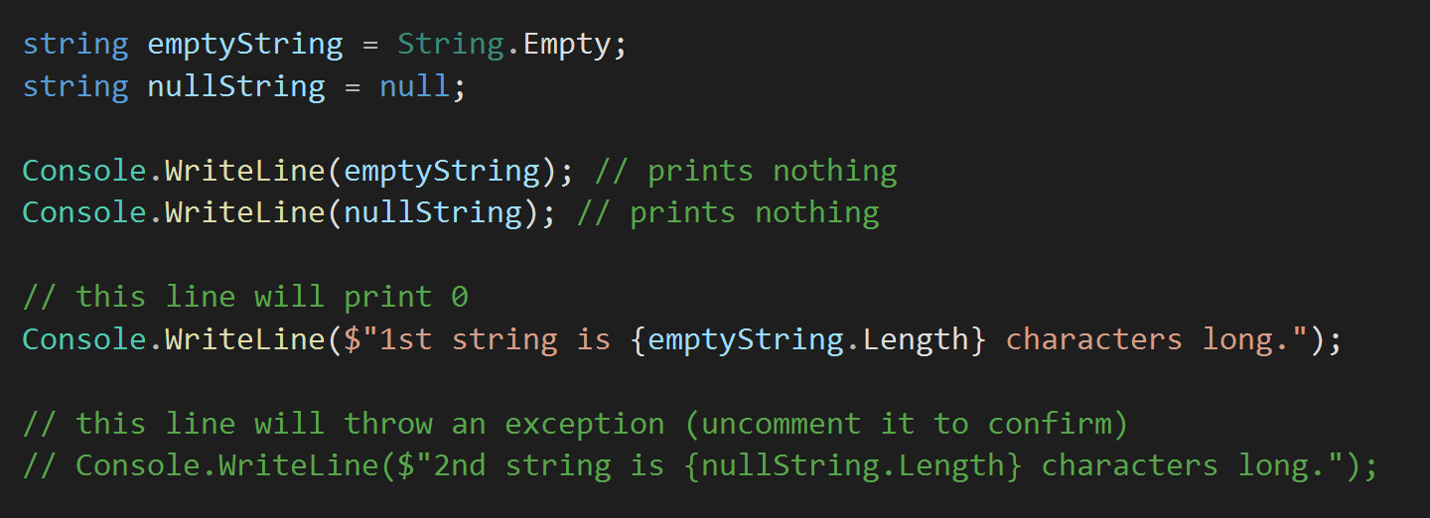
Zero Length VS Null String
Note that we cannot use the “.Length” command on a null string.
Run the program with the 2nd string line commented out, then run it with the 2nd string uncommented. The second will return a null exception.

Slide 28
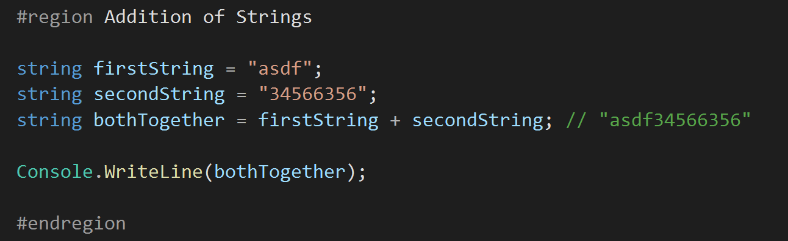
Addition of Strings
Additions will place two strings together.
Note that subtraction, multiplication and division will not work with strings.

Slide 29
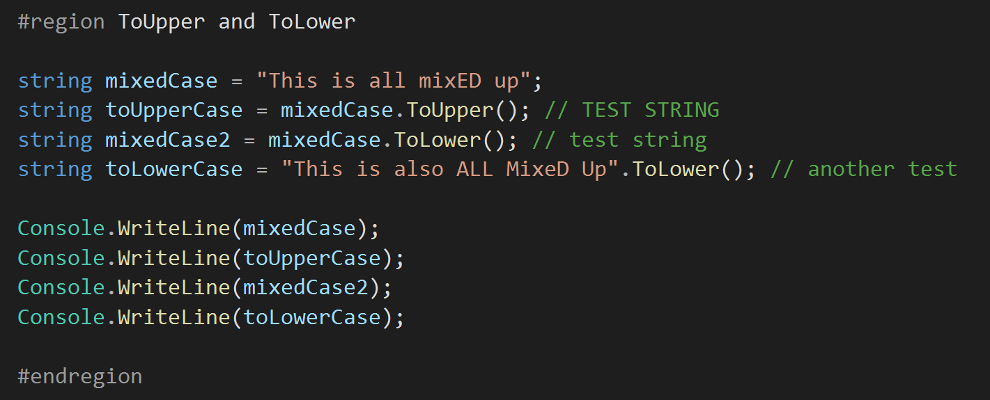
String.ToUpper() and String.ToLower
Strings can be formatted in different ways with different commands
ToUpper() – will make all characters UPPERCASE.
ToLower() – will make all characters lowercase.

Slide 30
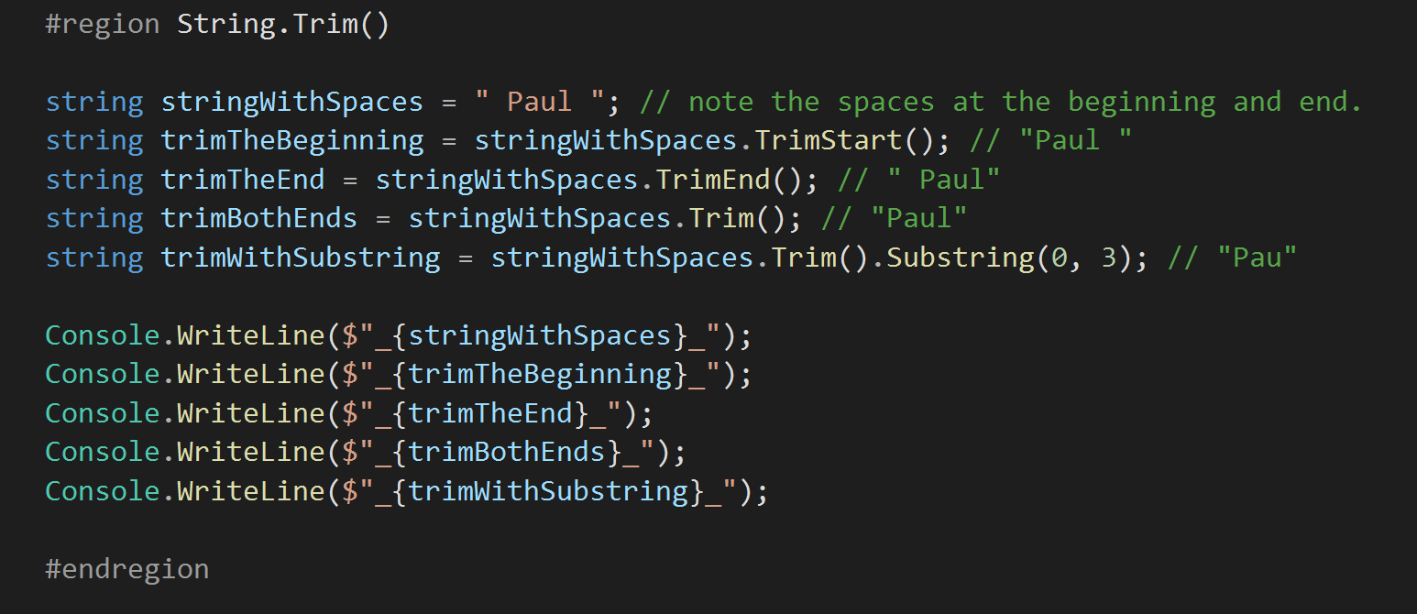
TrimStart(), TrimEnd(), Trim() and Substring(start, length)
Strings can be trimmed on either or both ends to ensure no whitespace is present.
Parts of strings can be extracted to get specific parts. Please note that the second argument is the LENGTH of the string you want and not the ending index.

Slide 31
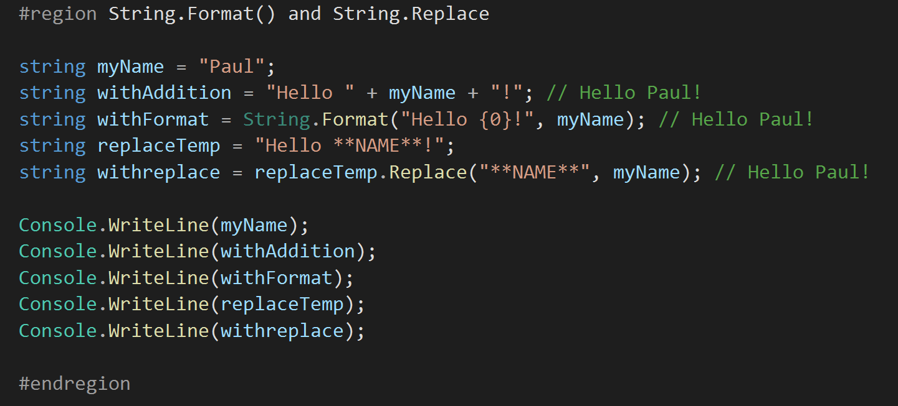
String.Format(string, string), String.Replace(string, string)
Format(string, string) can be used to create complex statements that take variables to replace the “indexes”.
Index starts with {0} and there must be the same number of variables and indexes. Thus, String.Format(“Hello {0} and {1}”, myName); will error.
Format(string, string) can be used to replace specific parts of a string with a different string. Avoid using this at all costs as it can be difficult to get correct and can cause unwanted errors in larger applications.

Slide 32
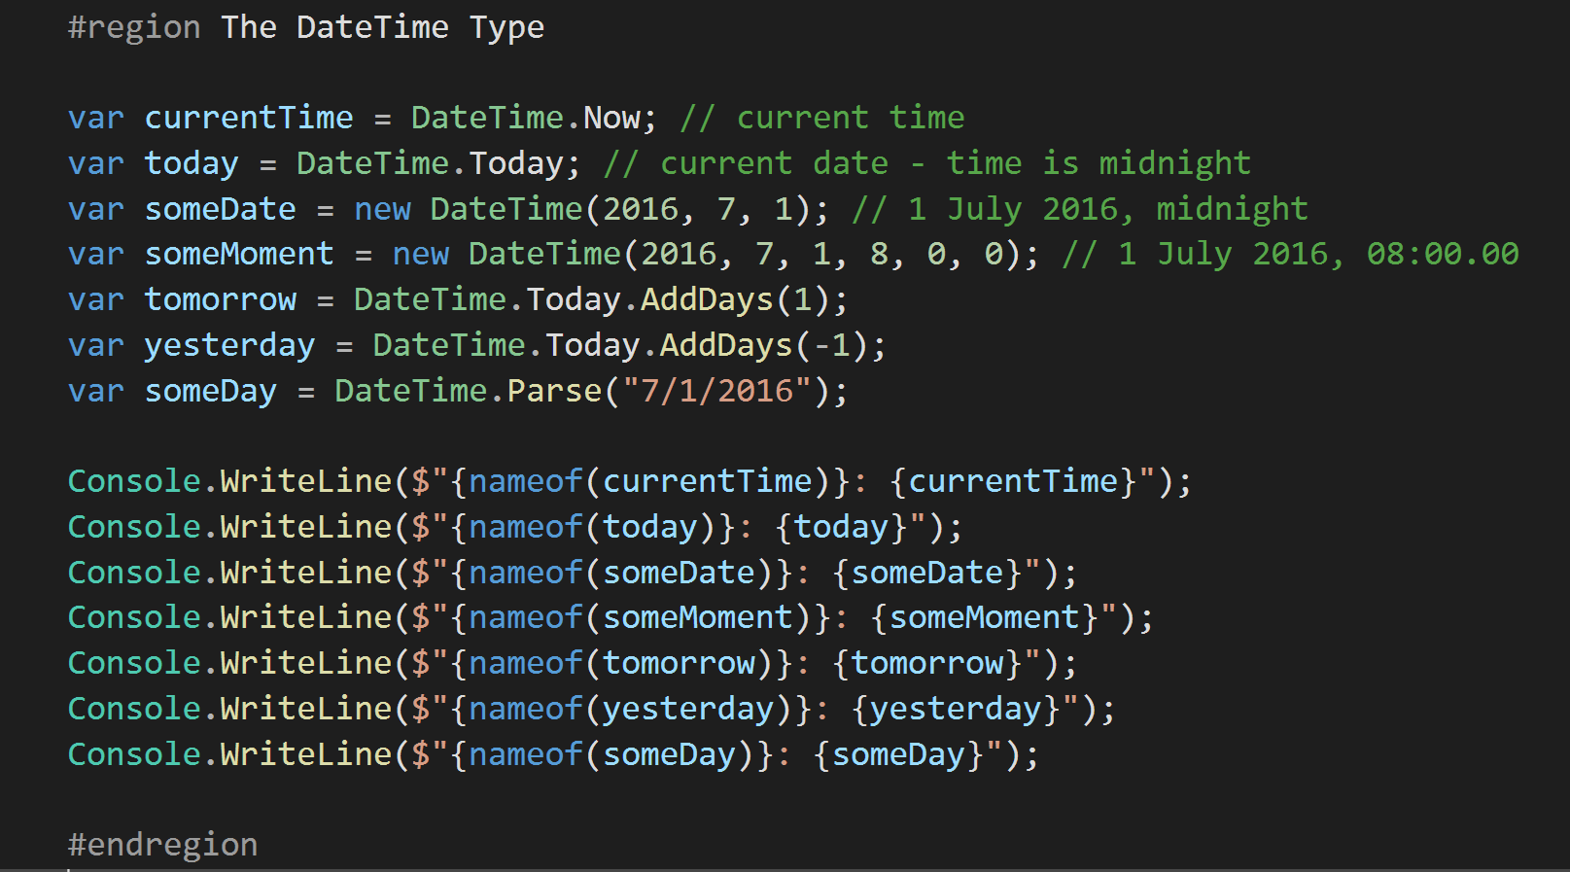
The DateTime Type
DateTime is a built in DataType for C#
It allows for easy access to commonly used Date and Time functionality

Slide 33
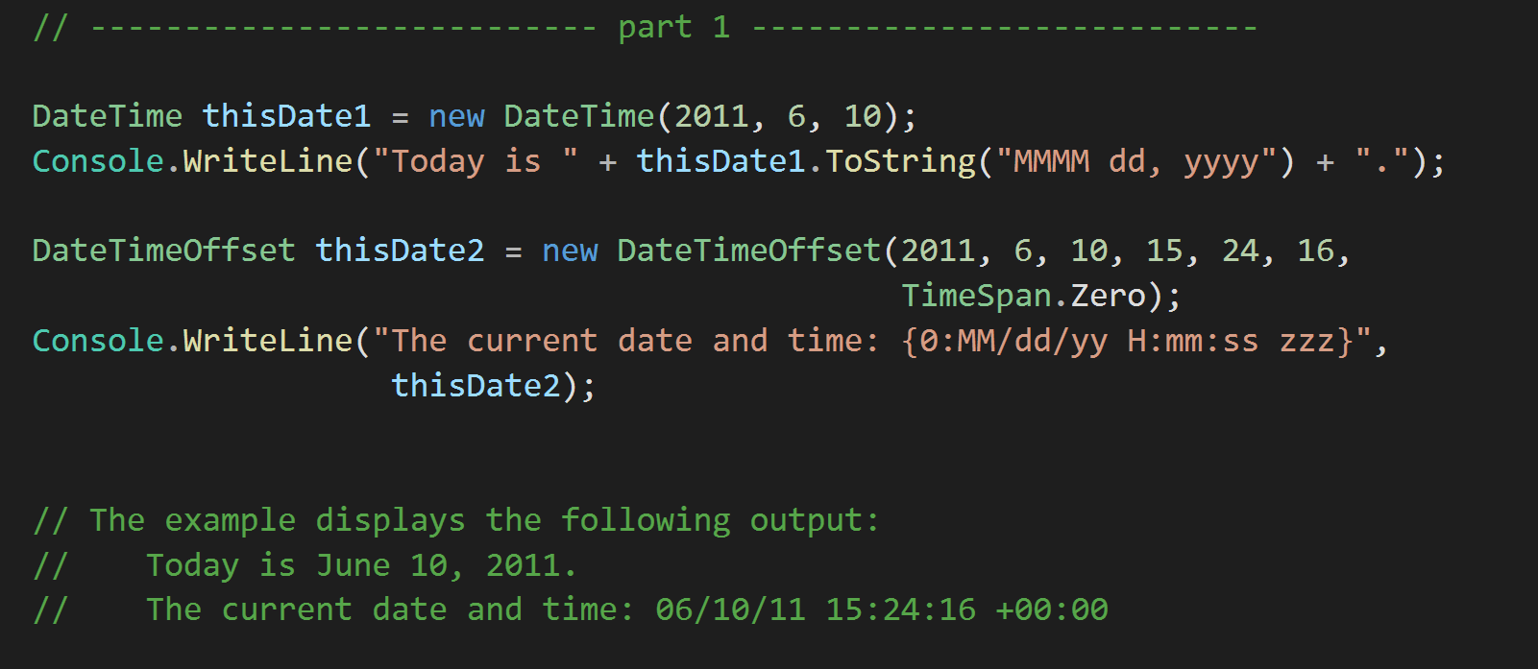
Formatting Dates and Times
When using a DateTime variable with the ToString Method, we can format the final outcome of the date in many ways. This is the most commonly used way of formatting string based outputs that contain dates.

Slide 34
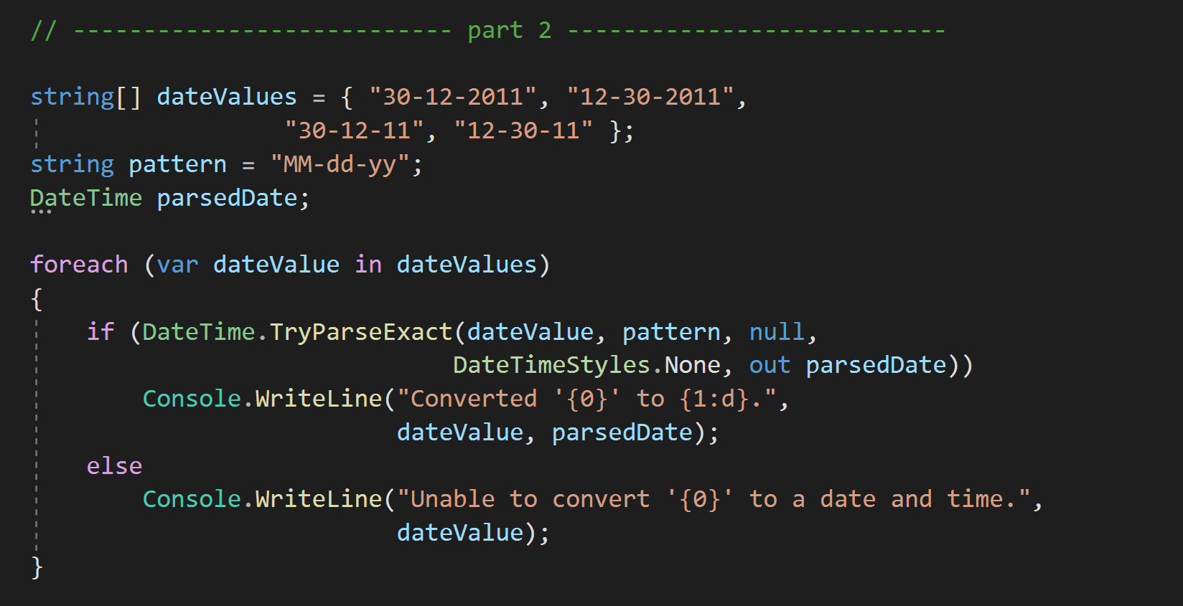
Formatting Dates and Times
Since different regions of the world format their dates differently, it’s also important to be able to “ATTEMPT” to parse a date that may fail. The “TryParseExact” is a method that we can use for this.
If successful, the “out parsedDate” will contain the formatted date and a true value will be returned from the method. If it fails, the “out parsedDate” will remain null and the method will return false.
This allows us to use this method in a logical expression to determine how to parse dates, or throw exceptions or handle the date in another manner.

Slide 35
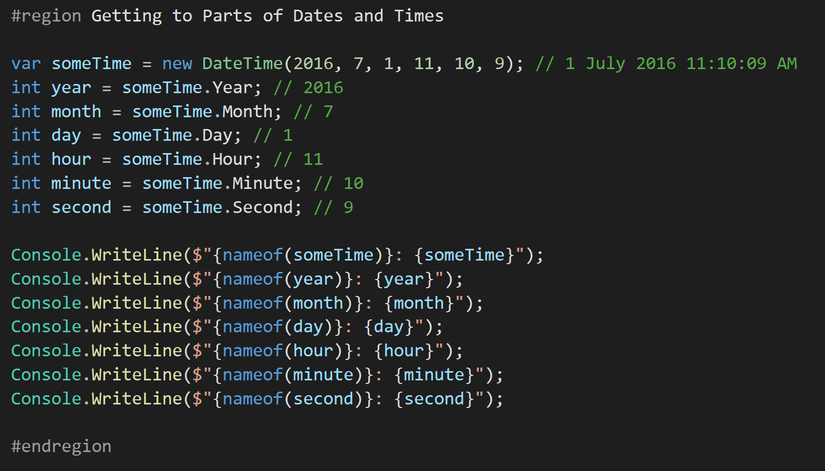
Getting to Parts of Dates and Times
It can be very handy to be able to pick out a particular part of a DateTime. We do not always need the entire date, but only a portion of the DateTime variable.
This also converts the return of the DateTime part into an int variable type that can be used to do Mathematical calculations for a date.

Slide 36
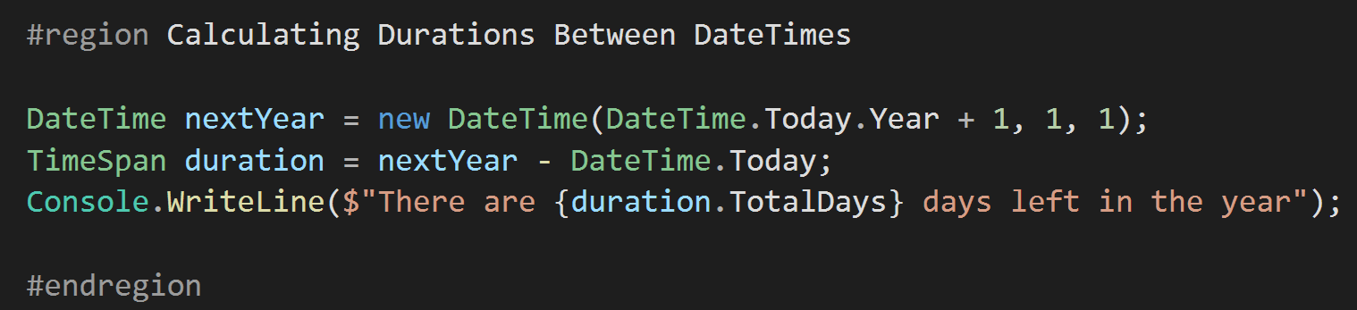
Calculating Durations Between DateTimes
There will be times that calculating the interval between times is important. This is a valuable tool when doing analytics that are based on timeframes.

Slide 37
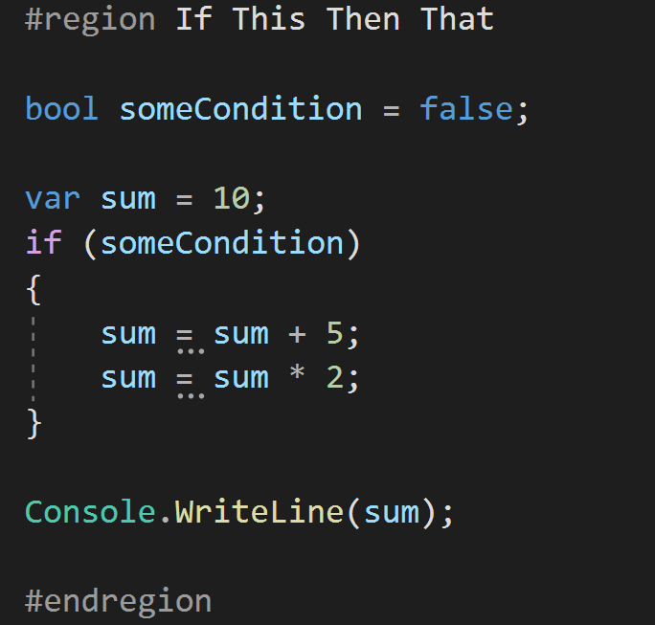
If This… Then DO That!
The most basic of conditional statements is the “if” statement.
It allows us to make a logical decision based on a condition. In the case above, if “someCondition = true” then the code inside the if { } will be executed.

Slide 38
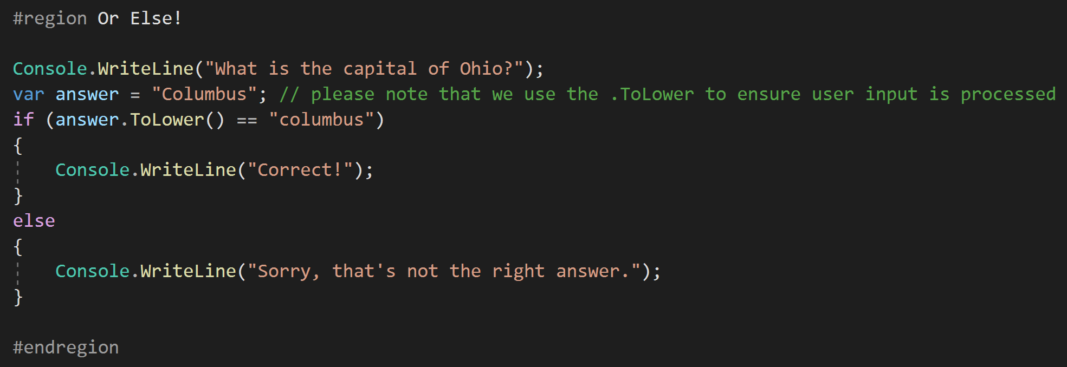
Or Else!
To extend the “if” statement to allow for a clause condition, the “else” statement is used.
This means that if the “if” condition is met, the “if” code will be executed. If it is not met, the “else” code will be executed.

Slide 39
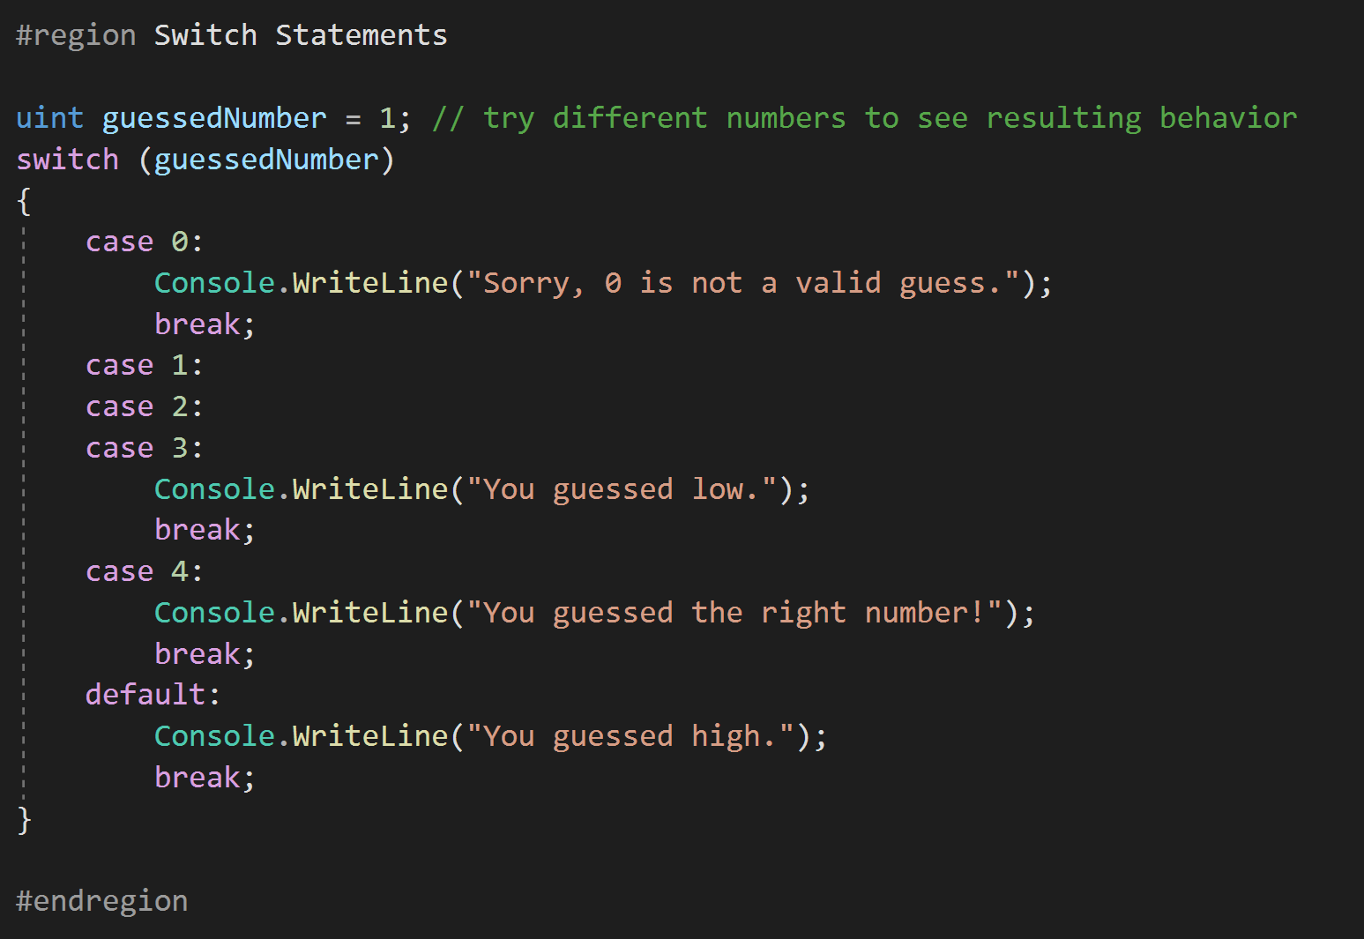
Switch Statements
When there are multiple “states” that need to be checked to determine the final block of code that needs to run, the “switch” statement is used.
This allows for different value conditions for a specific condition.

Slide 40
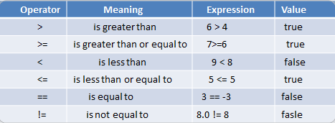
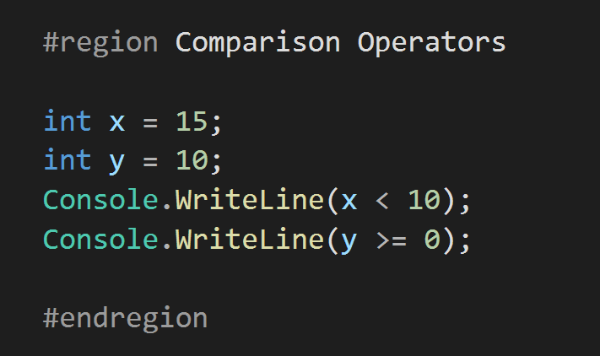
Comparison Operators
When comparing two items Comparison Operators are utilized.
The table above express a direct relation between the two objects being compared.
These are NOT limited to just int but can be used to compare any two objects, even Classes and complex objects.

Slide 41
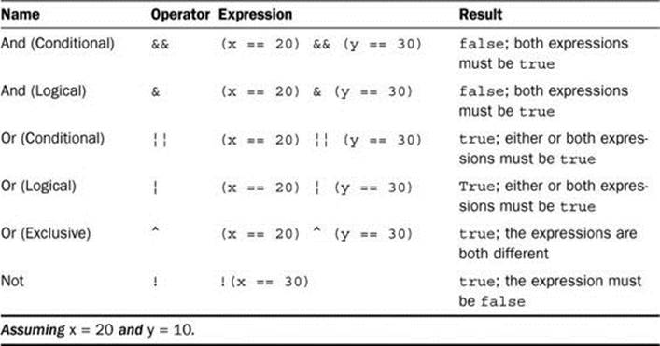
Logical(Conditional) Operators
When making complex logical decisions, Logical Operators are used. They are composed of simple operations that check the “True/False” state of both the left and right side and return a value according to the operator in use.
These are used widely when two separate larger operations are preformed and the results of those operations return a bool value. The two operations results will then be used to make a logical decision in a conditional statement such as an “if..else” statement.

Slide 42
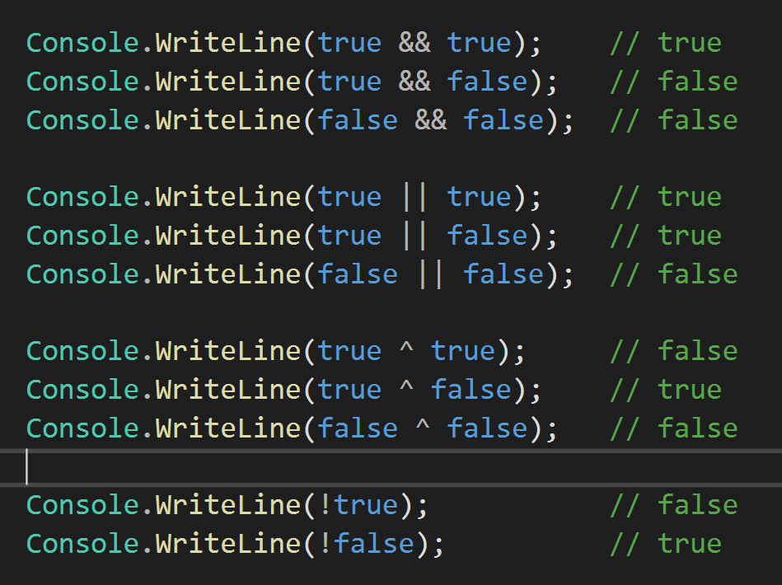
Logical(Conditional) Operators
Results from basic True/False bool values used with the Logical Operators

Slide 43
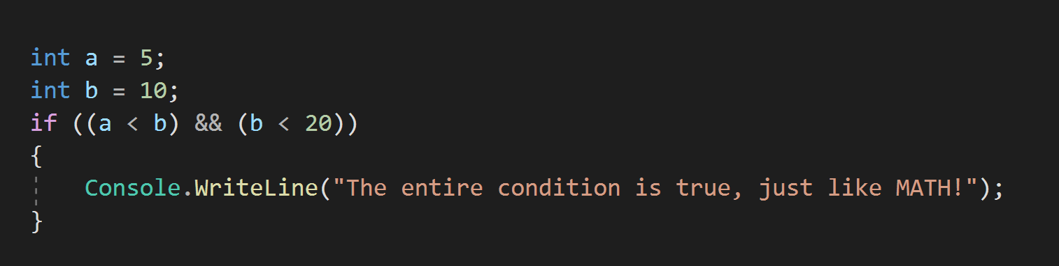
Logical(Conditional) Operators
Basic examples of the Logical Operators in use to determine if something should be written to the Console.

Slide 44
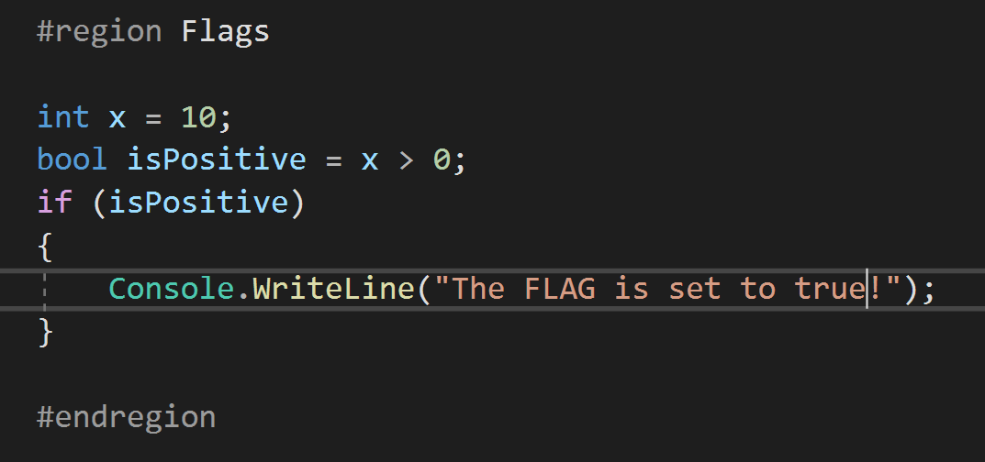
Flags (i.e. bool variables)
Many times bool variables are used as “FLAGS” or “SWITCHES” to turn on and off specific blocks of code at specific times.

Slide 45
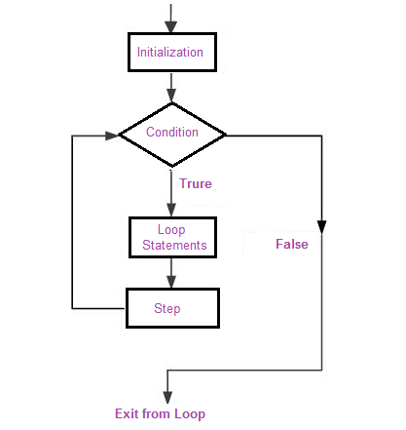
Looping Based on a Logical Expression
Being able to execute a specific block of code repeatedly given specific conditions is necessary.
Let’s say we need to print a list of items. Instead of writing a line of code for each item (which we may not know how many items there really are), we use looping and conditionals to solve a complex problem in a simple way.

Slide 46
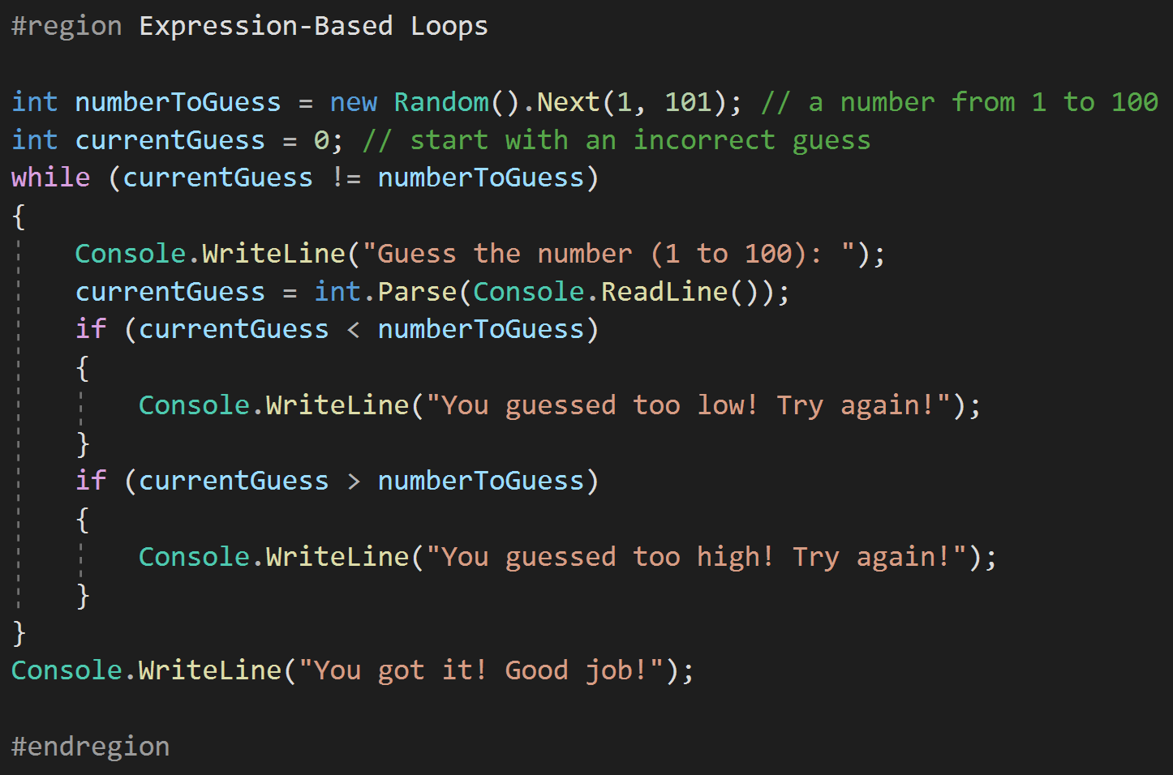
Expression-Based Loops
The while loop is used to ensure that an operation is performed until a condition is met, and then the operation stops.
The while can be placed at the beginning or the end of the loop. When placed at the end, the loop statements will be executed at least one time.

Slide 47
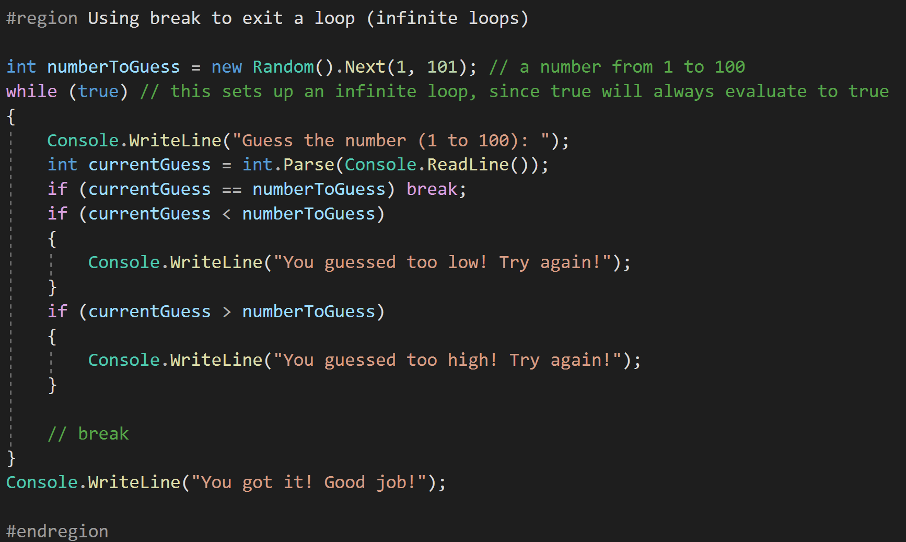
Using break to exit a loop (infinite loops)
A potential hazard with loops and conditions is when the condition never reaches a state of “false”. This will create an infinite loop.
The break statement can be used to forcefully exit a loop statement block.
Break is not typically used, but good programming practices ensure conditions will be met, or a final condition will always result to ensure loop termination.

Slide 48
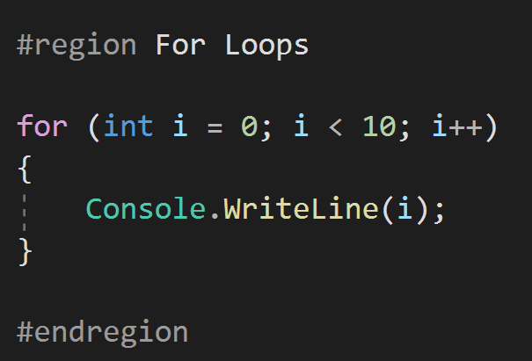
For Loops – When we want to do something (n) number of times.
A simple statement that executes the code between the {} when “i“ is from 0-9 (10 times due to the “off by one” problem).

Slide 49
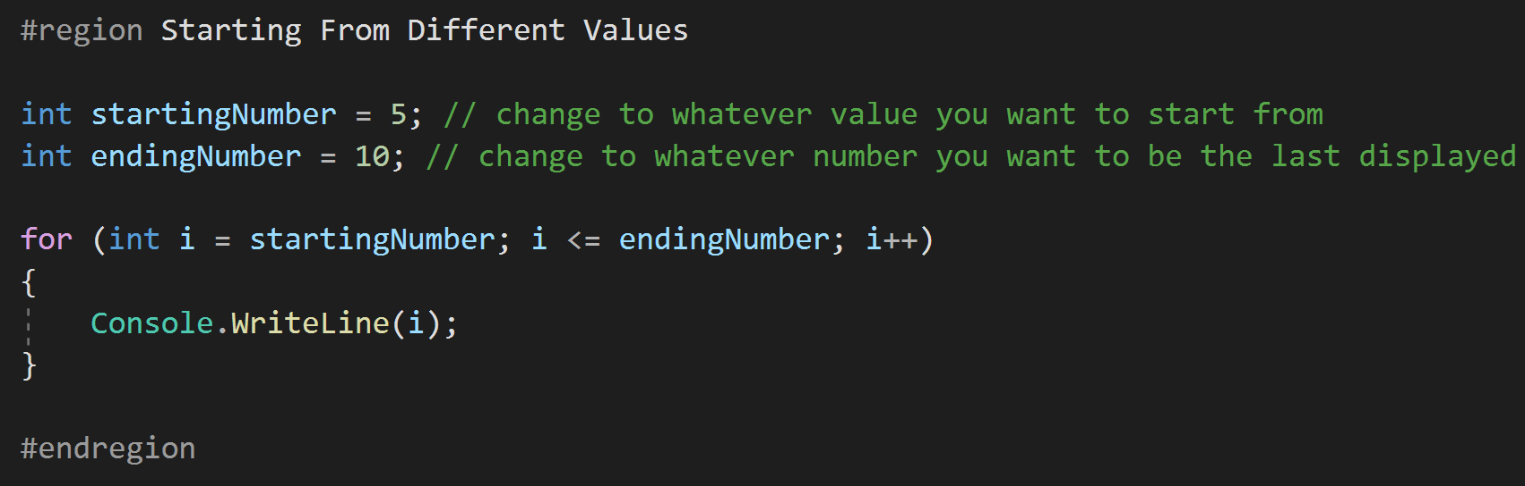
Starting From Different Values
We are not limited to starting at 0, but can use all types of numbers and variables to setup the conditions for a for loop.
This is not limited to just creating the variable in the loop start, but can be used with variables outside the scope of the loop as well.

Slide 50
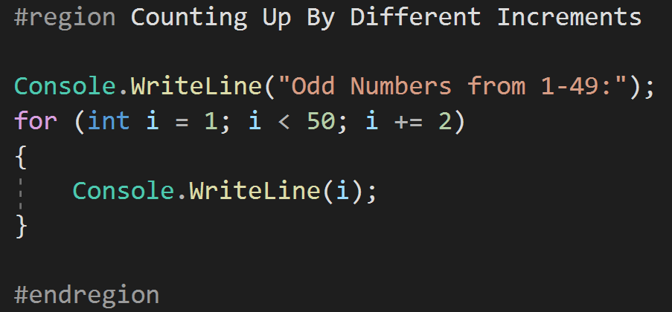
Counting Up By Different Increments
We are not restricted in the operation used to increase our count variable, but can create complex algorithms if necessary to function as a counter.

Slide 51
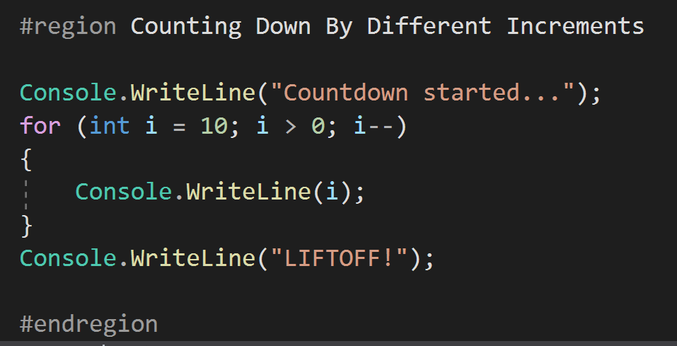
Counting Down By Different Increments
We can also count down. Again, the counting algorithm can be of any variety as long as we use good practices to ensure that the “middle” condition will be met at some point so the loop does not become infinite.

Slide 52
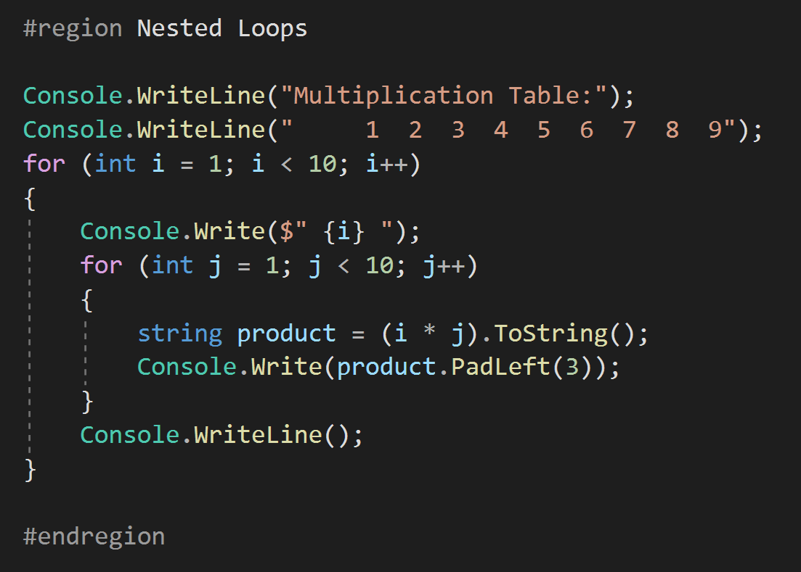
Nested Loops
Loops can be placed inside other loops to create complex operations.
This can be good, but nesting too many loops is a bad practice and difficult to debug.
The only restriction is that the scope of a variable must be assigned to a specific loop. In the case above, “i“ is used for the outer loop and “j” is used on the inner loop. This is a standard practice to start with “i“ and move up the English alphabet.

Slide 53

Creating Arrays
An array is a programming “object” or construct to store a series of the same type of object. These can be integers, strings, other arrays, or any type of class.
Object is the “BASE” class of all things created in .Net, and this means an array can store a list of ANYTHING, even a list of programs themselves.

Slide 54

Multi-Dimensional Array
Arrays are not limited to one dimension such as a shopping list for groceries.
Arrays can be any number of dimensions and are used extensively with mathematical operations in linear algebra where multiple variables can be tracked for Matrix calculations.
In this example, we create a 2-dimensional array. The array physically would be 2 columns with 6 rows.
Example 2 in the code shows the use of a 3 dimensional array. Anything beyond 3 dimensions is hard to represent physically, but mathematically it is viable.

Slide 55

Working with Arrays
Working with arrays is straightforward. To access a “cell” we need only select the appropriate index.
With multi-dimension arrays there is a hazard of mixing up which index is which and getting the wrong value.

Slide 56

Arrays and Strings
There are many operations that we can use when we have arrays of string values.
Two of the most common are Split and Join, however, there are others that may be used depending on the situation. We will cover these as needed through the rest of the course.

Slide 57

Creating Lists
Lists are very similar to Arrays, but offer many more functions such as sorting, removal and insertion.
Due to the additional “overhead” that lists have they do perform slower than Arrays, however, under 90% of all cases the performance reduction will not be a factor in determining to use them over an Array.
Lists will be the most commonly used “Collection” used in C# and .Net

Slide 58

Working with Lists
As stated before there are many additional operations that can be performed on Lists over Arrays.
This makes them the ideal “Collection” to use for many storage operations.
Note the difference between the Array.Length and the List.Count (this can confuse new programmers when they are working with both Lists and Arrays)

Slide 59


Working with Lists (ForEach)
Two important operations that are commonly used with Lists are the foreach and String.Join(string, List<type>).
These are built into the List Class and are one of the many features that Lists have that Arrays do not.

Slide 60

Other Options (for)
We are not limited to the foreach method of processing a List, but can again use the for loop with the “Count” of the List we are wanting to loop through.

Slide 61

Other Options (while)
We are not limited to the foreach method of processing a List, but can again use a while look with the “Count” of the List we are wanting to loop through.

Slide 62


Declaring and Calling Methods
Declaring a method is as simple as creating a “signature” and writing what the method does.
Calling the method is as simple as having another part of code use the “signature” created to execute the code in the method.

Slide 63


Declaring and Calling Methods with return types (Includes Overloaded Methods)
Some methods will return a value after performing an operation.
The “type” of variable returned is the “return type”
Remember, .Net is a “strongly” typed language. Everything needs a type.

Slide 64

Lambda Expressions
Lambda expressions are shortcuts for doing simple operations either through a “Func” or “Action”
A “Func” will have 2 arguments, the first is the input and the second is the return type
An “Action” will have only 1 argument and will have no return type.
Both “Func” and “Action” are types and can be passed to methods through arguments. This can allow for dynamic internal execution of code based on what is passed to a method. This is a more advanced topic than this lesson and will be covered in more detail in later lessons.

Slide 65

Lambda Expressions (Part 2)
Lambda expressions can also be used directly to create new “Func” or “Action” variables. This means that with proper construction complex and dynamic methods can be created from smaller pieces with little work.
In this example we use two small “Func” to create a more complex “Func”. The possibilities are endless, especially when we consider we can pass these as arguments to other methods that can be used to construct large operations based on the state of a given system.

Slide 66


Extension Methods
Extension methods are used to extend the functionality of the classes in .Net to provide functionality that will be used repeatedly without having to write the same code many times.
In the example, we have extended the int type to add 5 with the .PlusFive() extension method.
Note the signature of the extension method… (this int input);
Extension methods are declared outside of other classes and are always static.

Slide 67

LINQ Operations
LINQ (Language Integrated Query) is uniform query syntax in C# and VB.NET to retrieve data from different sources and formats. It is integrated in C# or VB, thereby eliminating the mismatch between programming languages and databases, as well as providing a single querying interface for different types of data sources.
Basically, it’s SQL for .Net, we can perform many operations on Lists with LINQ.
Count, Any, All, Where, Skip, Take, and Select are common operations.

Slide 68

LINQ Operations

Slide 69

LINQ Operations
With LINQ we can perform many demanding operations inline to create code that is easily readable.
One of the characteristics of a good programmer is that comments are considered to be secondary. This is because the code will be written in such as way that the code itself is the comments. With LINQ we can make it even easier for someone that did not write the code to read the code and understand what it does without comments.
Writing code that is readable like an instruction manual is considered a good practice, so naming conventions are VERY IMPORTANT!

Slide 70

LINQ Finding One Item in Collections firstOrDefault
firstOrDefault – This will allow us to select the first (or only) item in a list created from a LINQ statement.
We use firstOrDefault when you know that you will need to check whether there was an element or not. In other words, when it is legal for the sequence to be empty. You should not rely on exception handling for the check.
Note, setting up default values for Lists is beyond the scope of this lesson, but will be covered at a later time in this course.

Slide 71
LINQ Finding One Item in Collections lastOrDefault
lastOrDefault – This will allow us to select the last(or only) item in a list created from a LINQ statement.
We use lastOrDefault when we need to find the last element in a collection that matches a condition. We get either the last matching element or the default value.
Note, setting up default values for Lists is beyond the scope of this lesson, but will be covered at a later time in this course.

Slide 72

LINQ Finding One Item in Collections singleOrDefault
singleOrDefault – This will allow us to select the ONLY item in a list created from a LINQ statement.
This statement is used when ONLY one result from a LINQ is expected.
IF more than one result is retured from the LINQ, singleOrDefault will throw and exception.
This is used almost exclusively when a default value has been established. Therefore no exceptions will be thrown.
Note, setting up default values for Lists is beyond the scope of this lesson, but will be covered at a later time in this course.

Slide 73

LINQ Conversion of Lists
Using LINQ we can convert one type of List to either another type of List or an Array.
This can be used when we want to perform heavy operations on a large list without the performance hit from using a List to do the operation.
First, Convert the List to an Array
Then, perform the desired operation
Finally, remove the reference to the Array if it is no longer needed (for memory resource reasons)

Slide 74

Exception Handling Basic Try/Catch
It is always good to ensure we do not make mistakes in our code, handling exceptions is an important part of ensuring that a program does not “CRASH”
NOTE: We want to avoid exception handling by creating clean code that does not “crash” due to the large amount of computer resources that it takes to create an exception. Therefore, situations where try/catch blocks are in loops are not considered good practices.

Slide 75
Exception Handling Basic Try/Catch
It is always good to ensure we do not make mistakes in our code, handling exceptions is an important part of ensuring that a program does not “CRASH”
NOTE: We want to avoid exception handling by creating clean code that does not “crash” due to the large amount of computer resources that it takes to create an exception. Therefore, situations where try/catch blocks are in loops are not considered good practices.

Slide 76

Exception Handling Throwing Exceptions again (Bubbling up)
Using “nesting” we can “bubble up” and exception from deep within the execution of a program to the top most layer.
With the current example it is difficult to understand, but when many classes and methods are being executed one after another, it can be important not to lose which method or class is at fault for creating an error. “Bubbling up” can help with this, but needs to be considered as a potential bad practice if done extensively.

Slide 77

Exception Handling Custom Exceptions
As a programmer we can “throw” our own exception at any time. This can sometimes be used to ensure critical parts of a system operate as expected and when they do not, a custom exception can be created and thrown. This will be used to help pinpoint error location and help with ensuring easy maintenance on a system.

Slide 78

Exception Handling Finally Block
The finally block of a “try/catch/finally” will ALWAYS execute, even if an exception is not thrown.
This is critical for performing some actions that MUST take place regardless of if a block of code fails and throws and exception.
For example, freeing up and disposing of resources that could be critical for a system.
Another example would be to ensure that a system returns to a certain state after an operation, even if the operation was not successful.
Also, there are times when even within the catch block another exception occurs unexpectedly. The finally block will ensure that a set of code is always ran, no matter what.
The ONLY exception is a frozen system where the operation of the entire application has stopped.

Slide 79

Exception Handling Exception Filtering
Multiple catch blocks can be used to provide “filtering” to exception handling. This means that we can handle different exception types differently.
NOTE: There is a hierarchy of exception types that must be followed when setting up the different catch block order, else we may get unexpected results.
The order of these exceptions are not part of this lesson and should be researched independently if needed for real-world code.

